Slide 1
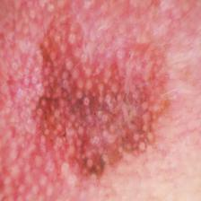
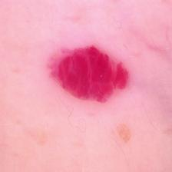
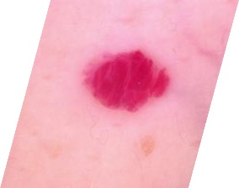
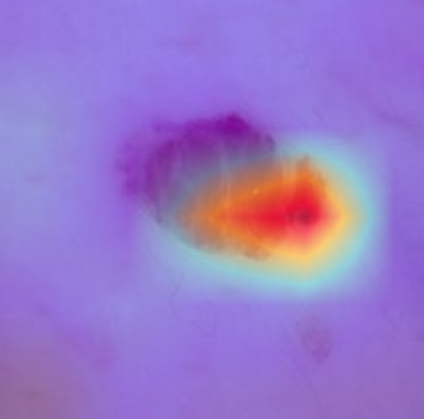
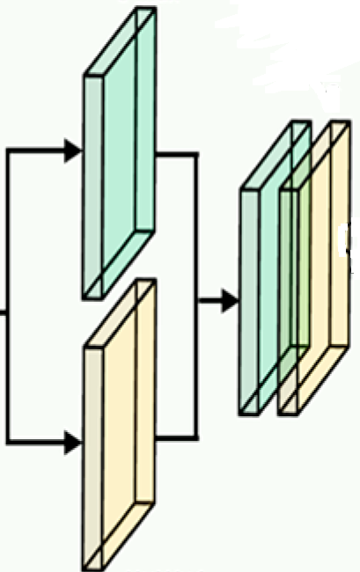
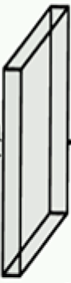



Training 70%
Training Augmentation
Imbalanced
HAM10000 &
ISIC2019 Dataset
Augmentation
Balanced
HAM10000 &
ISIC2019 Dataset
Apply CLAHE to YUV,
Y Channel
Clip Limit = 1%
Validation 20%
Rotation 17°
Zoom 16%
Shear 12%
Horizontal Flip
Width Shift 13%
Height Shift 13%
Fully Connected Layer
Testing 10%
Resize: 224×224×3
fill_mode = nearest
GradCam++
Visualization
ReLU
Input: 224×224×3
Softmax Layer
ReLU
Xception
InceptionV3
InceptionResNetV2
Classified Output +
Last conv layer
(conv_7b) features
Best Performing Triplet Combination
Dropout = 0.35
Dropout = 0.45
CBAM Layer
CBAM Layer
CBAM Layer
Trained
Model
….
Dropout = 0.25
….
….
$n_{c}$ unit
GlobalMaxPooling
GlobalMaxPooling
GlobalMaxPooling
Accuracy
Precision
Recall
F1 Score
AUC
$$64 unit$$
L2=1e-4
$$256 unit$$
L1=1e-4, L2=1e-3
Concatenated
Features
Act. = ReLU
Max pooling
H×W×1
Filters=1
Kernel Size=7
Strides=1
Feature: H×W×C
Global max pooling
C/16
C
Global max pooling
Feature: H×W×C
Concatenation
H×W×2
H×W×1
CBAM
Features
1×1×C
Convolutional
2D
H×W×C
Global avg pooling
Global avg pooling
Convolutional
Feature H×W×1
1×1×C
Shared Dense Layer with
Kernel Initializer=he_normal
Avg pooling H×W×1
Channel Attention Module
Spatial Attention Module
H= Height, W= Width, C= Channel, Act= Activation Function
Element-wise Addition
Element-wise Product
Sigmoid Activation

Slide 2
Act. = ReLU
Max pooling
H×W×1
Filters=1
Kernel Size=7
Strides=1
Feature: H×W×C
Global max pooling
C/16
C
Global max pooling
Feature: H×W×C
Concatenation
H×W×2
H×W×1
CBAM
Features
1×1×C
Convolutional
2D
H×W×C
Global avg pooling
Global avg pooling
Convolutional
Feature H×W×1
1×1×C
Shared Dense Layer with
Kernel Initializer=he_normal
Avg pooling H×W×1
Channel Attention Module
Spatial Attention Module
H= Height, W= Width, C= Channel, Act= Activation Function
Element-wise Addition
Element-wise Product
Sigmoid Activation

